Slide 1
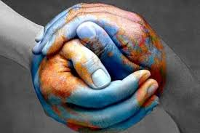
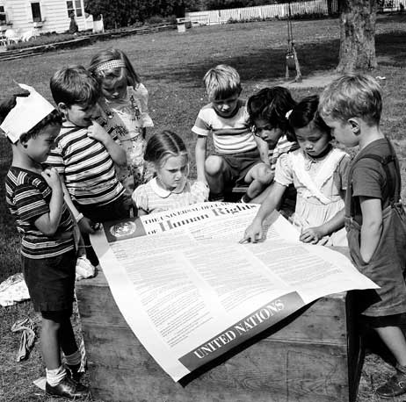
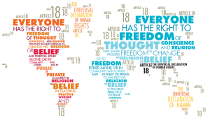
THE UNIVERSAL DECLARATION OF HUMAN RIGHTS
The Universal Declaration of Human Rights is a milestone document in the history of human rights. The Declaration was proclamed by the United Nations General Assembly in Paris on 10 December 1948 and it has been translated into over 500 languages.
It has 4 foundamental points:
Maintain International Peace and Security
Protect Human Rights
Deliver Humanitarian Aid
Promote Sustainable Development

Slide 2
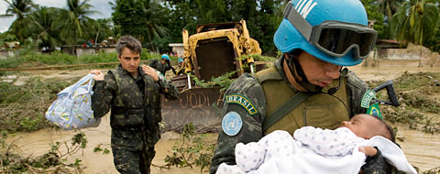
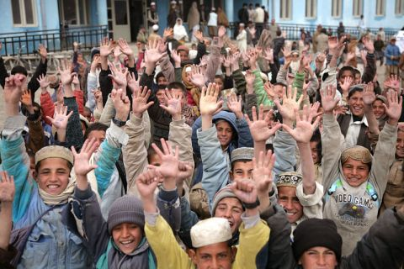
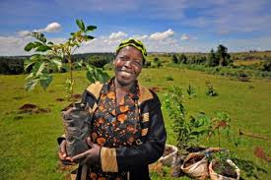
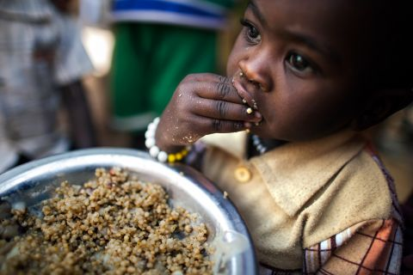
Maintain International Peace and Security
The United Nations came into being in 1945,following the devastation of the Second World War, with one central mission: the Maintence of International Peace and Security. The United Nations maintain international peace and security with the protect civilians, assist in the disarmament and reintegration.
Protect Human Rights
In 1948 The Universal Declaration of Human Rights brought human rights into the realm of international law. The Organisation has protected human rights through legal instruments and activities. For example in Kabul, Afghanistan was made an International campaign advocating free, quality education for all.
Promote Sustainable Development
Deliver Humanitarian Aid
From the starting 1945 the United Nations has changed the world with the sustainable development that promotes prosperity and economic oppurtunity
The UN first did this in the aftermath of the Second World War on the devasted continent of Europe ,which it helped to rebuild.
More than 8,000 women and children living in the camp benefit from nutrition programmes run by the World Food Programme (WFP)

